Slide 1

Encounter Claim Cost and Payer Coverage Dashboard

Slide 2
Purpose
Explore the interaction between encounter claims costs and payer coverage within patient demographics and encounter class to gain insights to improve reimbursement and patient care.

Slide 3
Why?
Understanding the reimbursement patterns of payers is necessary for sustainable viability

Slide 4
Key Metrics
Total Number of Patients
Average Encounter Claim Cost
Total Encounter Claim Cost
Total Encounter Payer Coverage
Payer Coverage Percentage: ratio of encounter payer coverage to encounter claim cost
Total Number of encounters

Slide 5
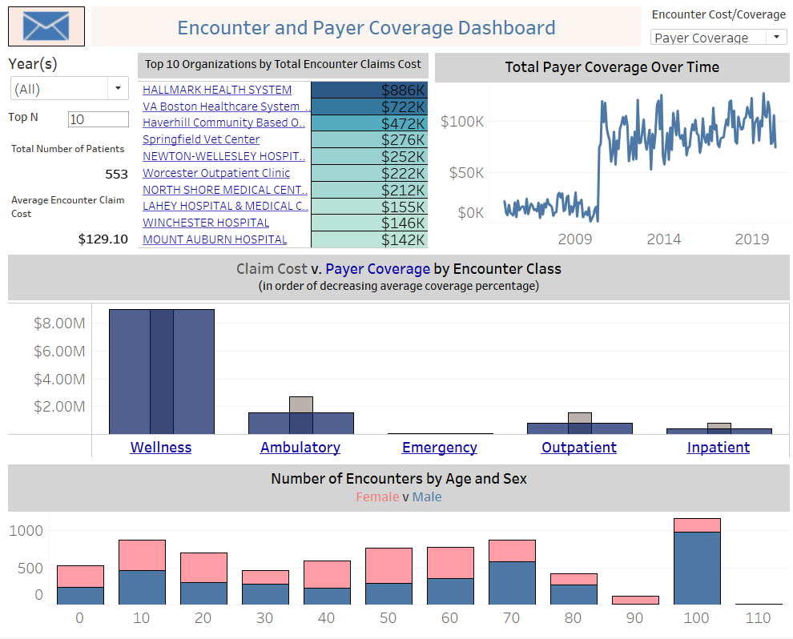

Slide 6

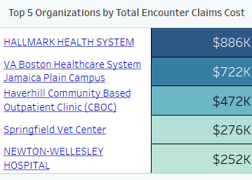
Visualization 1
Parameter:

Slide 7
Visualization 1
Why this type of visualization?
This visualization provides an avenue to see the top 1-15 from 519 organizations without being overwhelming and misleading as it will be with a tree map or pie chart which will show part of a whole only in the visualization and not the whole data.

Slide 8
Visualization 1 Data Summary
The top 5 organizations had between $252,000 and $886,000k in encounter claims cost.
Of the top 5 organizations, two are healthcare systems.

Slide 9
Visualization 1 Insights
Data: This shows the top selected number of organizations by total encounter claim cost.
Action: Clicking any organization filters the whole dashboard to provide organization-specific information.

Slide 10

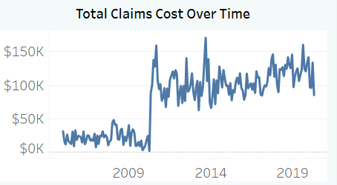

Visualization 2
Tooltip:

Slide 11
Visualization 2 Why this type of visualization?
A line chart perfectly shows the trend of a measure over time.
Filtering for a year will show the trend over the months in that year

Slide 12
Visualization 2 Data Summary and Insights
This shows the trend of total encounter claims cost and encounters payer coverage over time.
Encounter payer coverage is almost always lower than the encounter claim cost and they follow a similar trend across the months and years.
This shows that even if coverage does not always cover the cost, coverage follows the pattern of the cost.

Slide 13
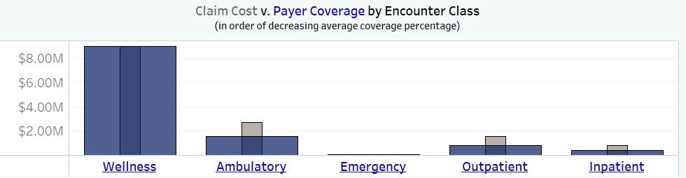
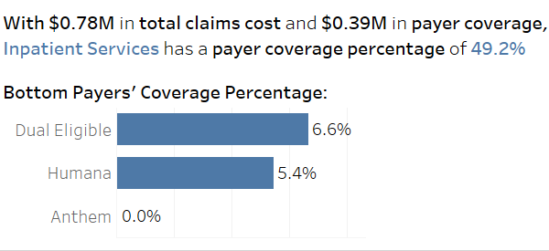
Visualization 3
Tooltip:

Slide 14
Visualization 3 Why this type of visualization?
This chart adequately shows two measures in each dimension and a visual representation of the difference between the measures.

Slide 15
Visualization 3 Data Summary
Data shows the amount difference between the claim cost and payer coverage by encounter class
Tooltip: Shows the payers who cover the least claim percentage in each encounter class and how much they covered
Action: Selecting an encounter class filters the Age/Sex visualization and directs to another dashboard that shows the encounter descriptions in each encounter class and its payer coverage percentage

Slide 16
Visualization 3 Insights
This shows that for all organizations and years, inpatient services have a lower coverage percentage than other encounter classes and the payers that pay the least percentage are Dual eligible, Humana and Anthem
The second dashboard this visualization directs to, shows which encounter descriptions have the lowest and highest coverage percentage.

Slide 17
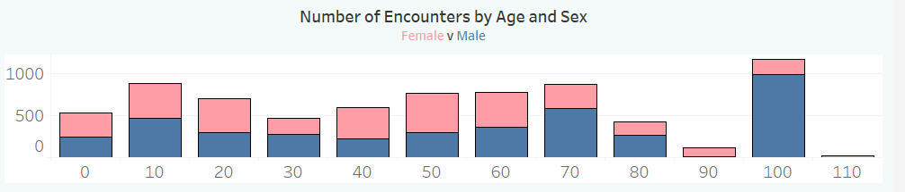
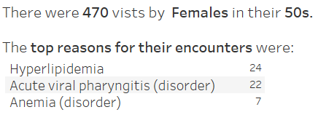
Visualization 4
Tooltip:

Slide 18
Visualization 4 Why this type of visualization?
This appropriately show how much encounters each age group compared to others and the distribution of sex within each age group.
This will not be easily and clearly achieved in any other visualization

Slide 19
Visualization 4 Data Summary
Data: shows the number of encounters for each age group and each sex within each age group
Tooltip: Shows the top encounter reasons patients had in each demographic
Action: Selecting an encounter class filters this visualization.

Slide 20
Visualization 4 Insights
For all organizations and years, patients between 100-108 years old had the most encounters and they were mostly males.
The top encounter reasons for these men in this age group were chronic congestive heart failure, hyperlipidemia, and acute viral pharyngitis

Slide 21
Bringing it Together
For all organizations and years:
Encounter payer coverage is smaller than encounter claim cost and both trend similarly over time.
The percentage amount payers cover encounter claim costs are highest for wellness services and lowest for inpatient services
Most encounters for inpatient services are for women in their 20s and 50s

Slide 22
Bringing it Together
For inpatient services in all organizations and years:
For women in their 50s the top encounter reasons were hyperlipidemia, acute viral pharyngitis, and anemia.
For women in their 20s the top encounter reasons were acute viral pharyngitis, chronic pain, and chronic intractable migraines.
Within inpatient services in the 2nd dashboard, encounters for symptoms and periodic reevaluation and management of healthy individuals are encounter descriptions with no payer coverage.

Slide 23
Conclusion
The insights from bringing the visualization together can help organization know payer’s tendencies in their coverage of encounter claim costs and can offer the organizations information that can be used in reimbursement negotiations and possible restructuring of care

